Slide 1

RESUME CLASSIFICATION
GROUP-6
MENTORS-IFTEKER PATEL

Slide 2
TEAM MEMBERS
Prakash Waghmare
Sumit Musale
Manish kumar srivastava
Sayali Kashid
Shital Chumbhalkar
Aman Sahu
Gaurav Sonewane
Asim Ansari

Slide 3
CONTENTS
OBJECTIVE
DATA EXTRACTION
EDA
MODEL BUILDING
DEPLOYMENT

Slide 4
OBJECTIVE
The document classification solution significantly reduce the manual human effort in the HRM. It should achieve a higher level of accuracy and automation with minimal human intervention.
The purpose of resume classification is to automatically organize resumes based on their content, which includes skills, experience, education, and other relevant data. This can help employers or recruiters strongly look for candidates who meet their requirements for a particular job or position.

Slide 5
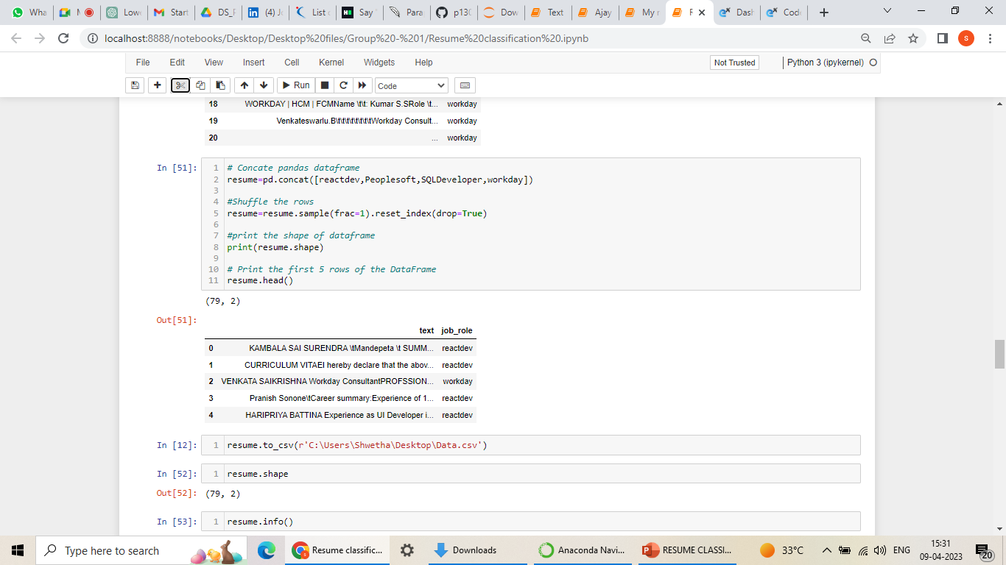
EXTRACTION OF DATA
There are enough libraries to extract the text and pdf files.
We used the libraries pypdf, doc, and os to extract the data.
It has 79 rows and 2 columns. There are no null values and 2 duplicates.

Slide 6
EXPLORATARY DATA ANALYSIS (EDA)

Slide 7
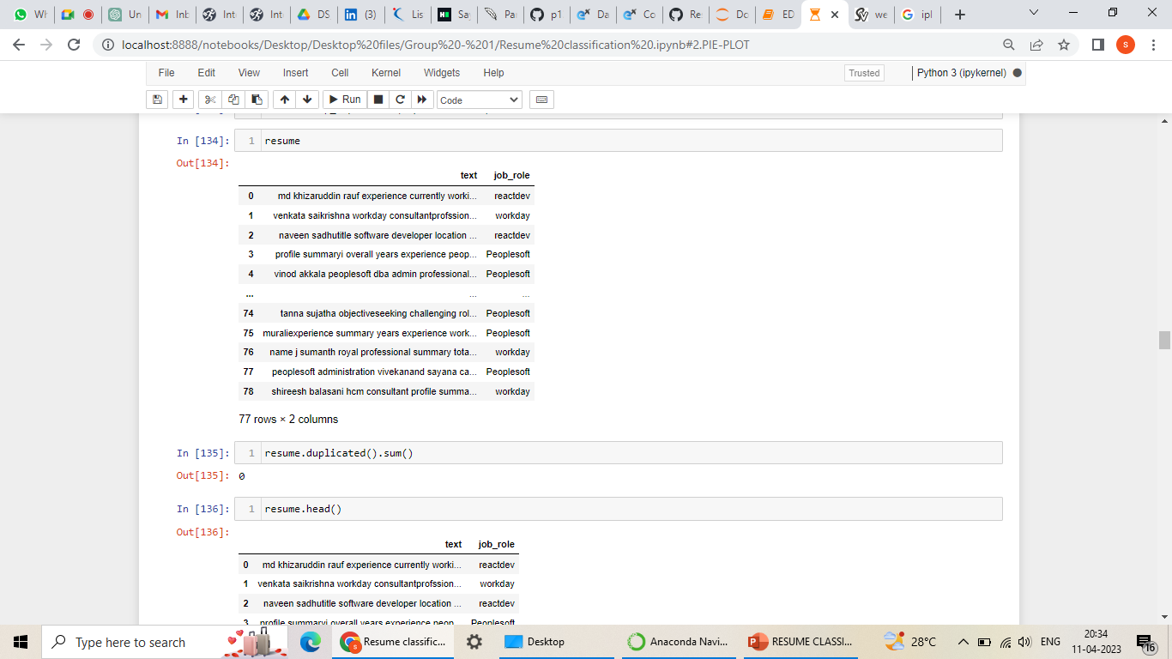
DATA CLEANING
Removed duplicates, non-English characters, punctuation and numbers.
It has 77 rows and 2 columns.

Slide 8
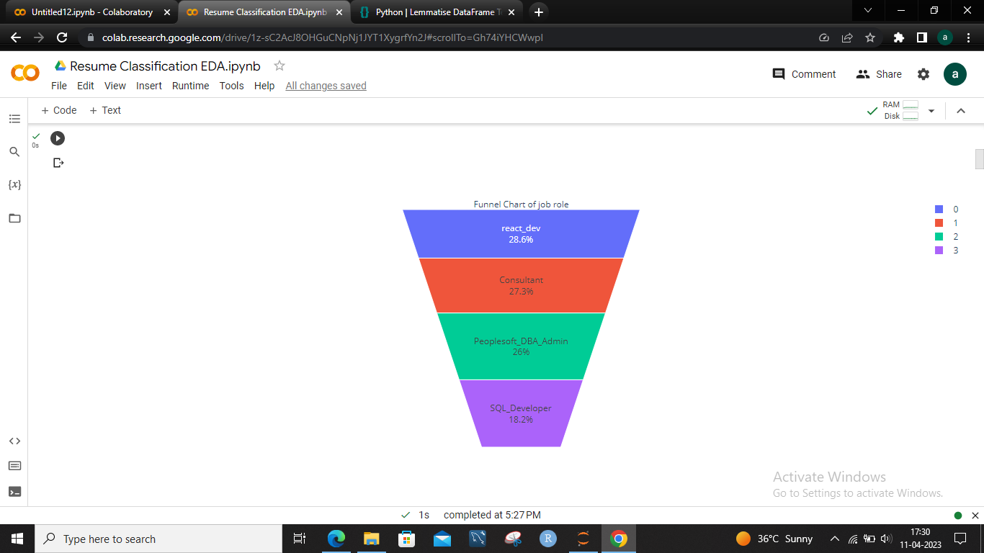
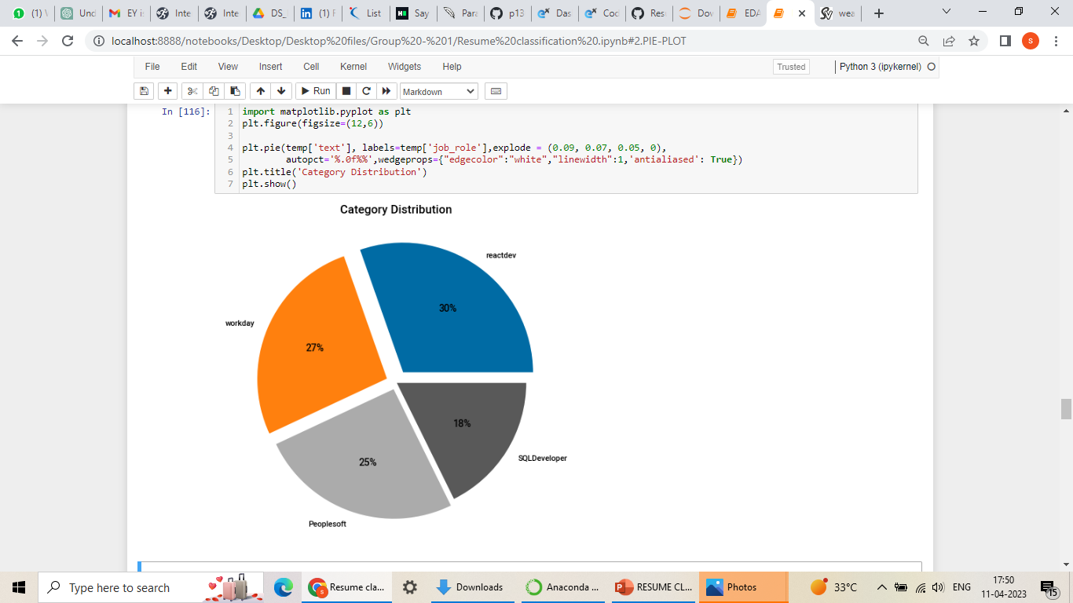
1. PROPORTION OF RESUME DATA
1. FUNNEL CHART CHART:
2. PIE CHART:
We estimated the percentage of resumes in each job role.
Here the react-developer contains highest percentage of resumes and SQL-Developer contains less percentage of resume.

Slide 9
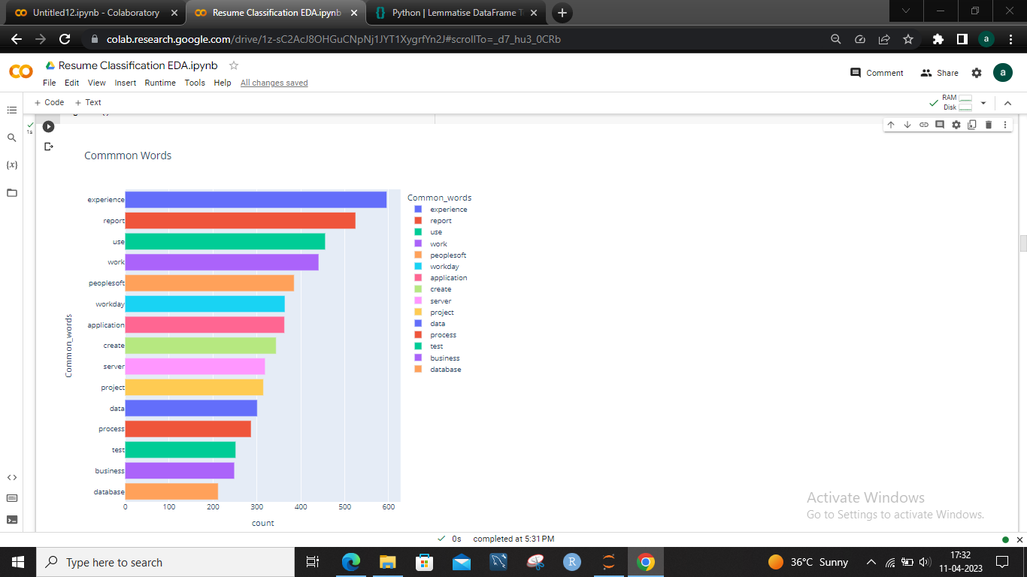
2. COMMON WORDS
It represents which is the most common word in the data set. We can see here there are 15 common words in which the term EXPERIENCE is the most common.

Slide 10
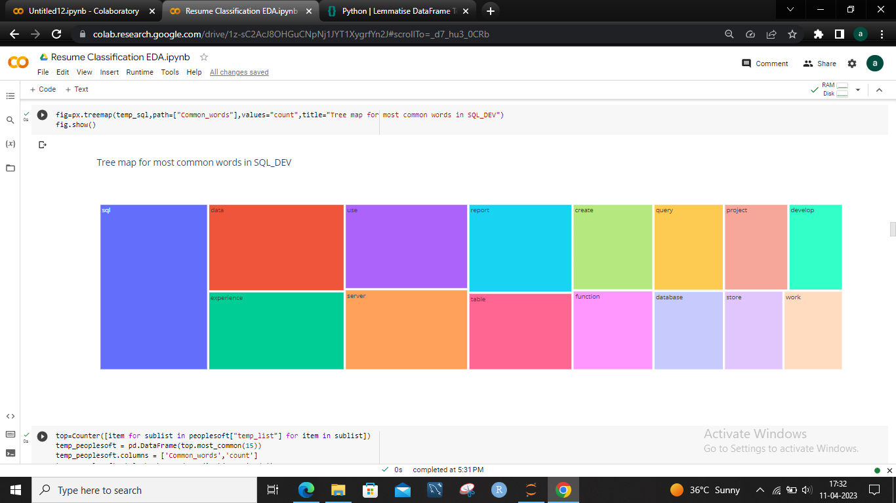
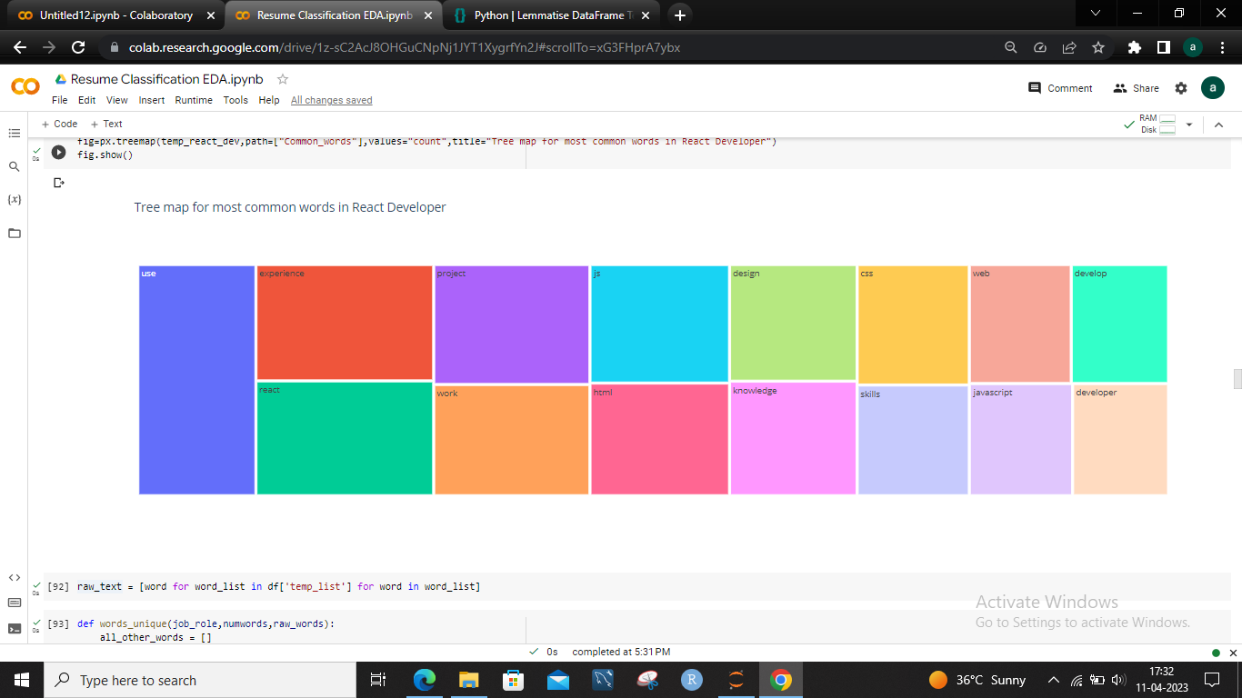
1.SQL DEV
3.COMMON WORDS REPRESENTATION USING TREE MAP
Here the word SQL contains highest number of words.
2.REACT_DEV:
Here the word USE contains highest number of words.

Slide 11
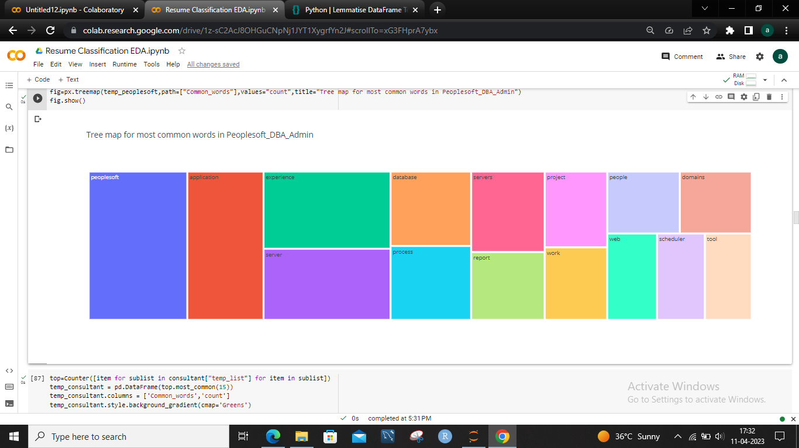
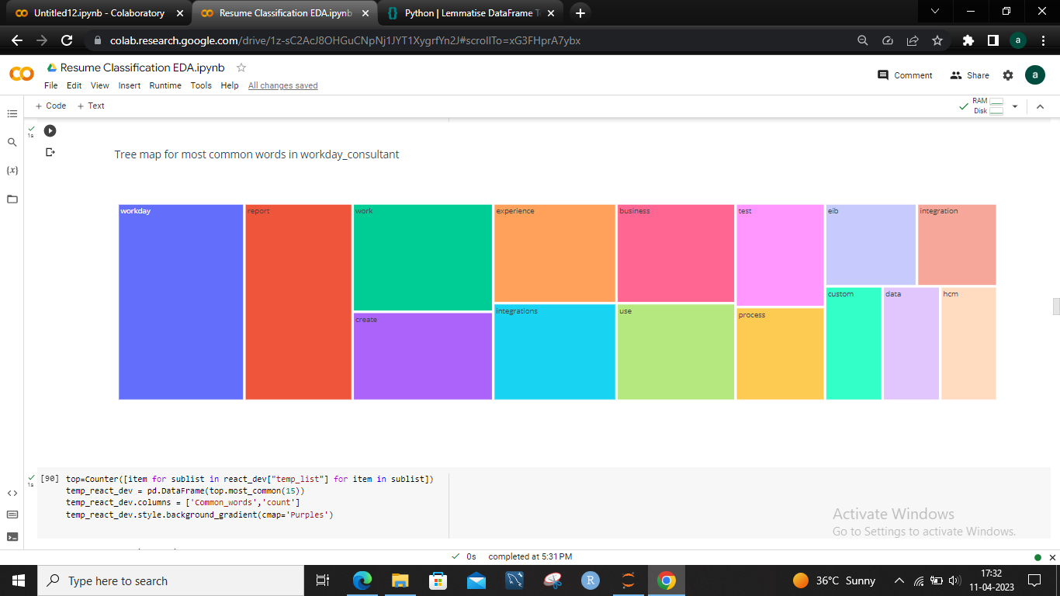
3.PEOPLESOFT:
Here the word Peoplesoft contains highest number of words.
4.WORKDAY:
Here the word workday contains highest number of words.

Slide 12
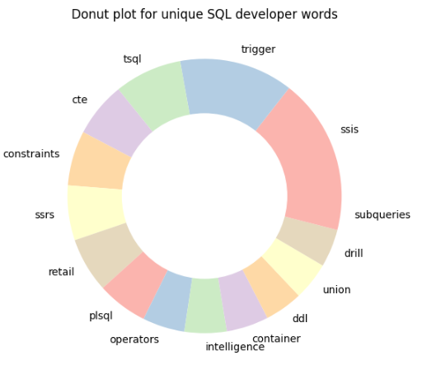
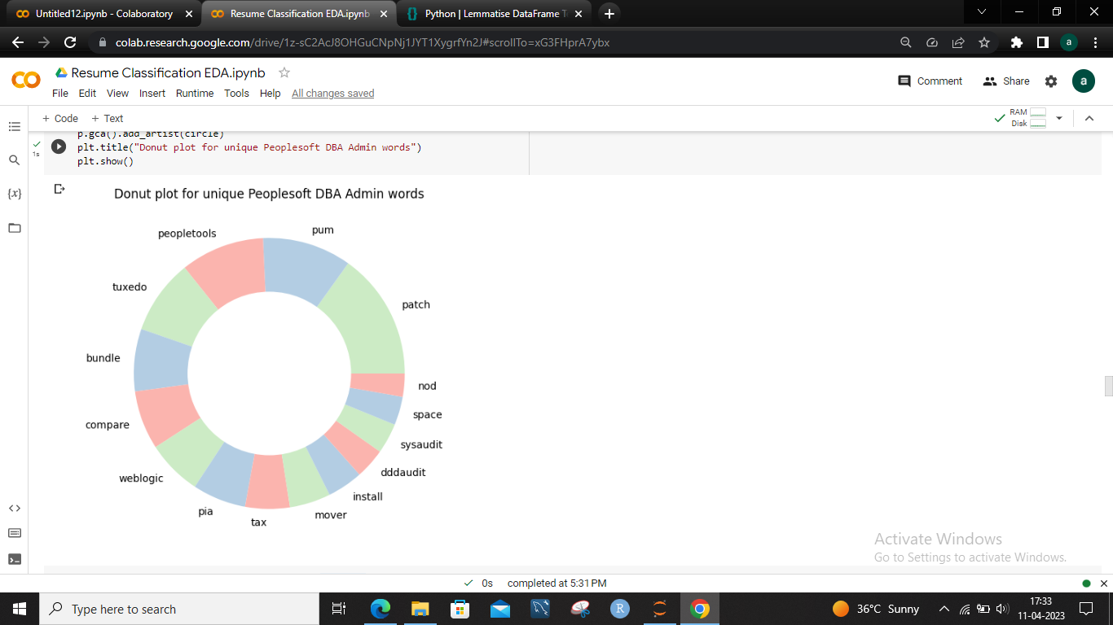
4.UNIQUE WORDS REPRESENTATION USING DONUT PLOT
1.SQL_DEVELOPER:
2.PEOPLESOFT :
The donut plot represents the unique words in each category.

Slide 13
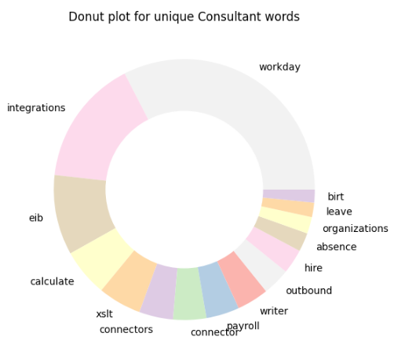
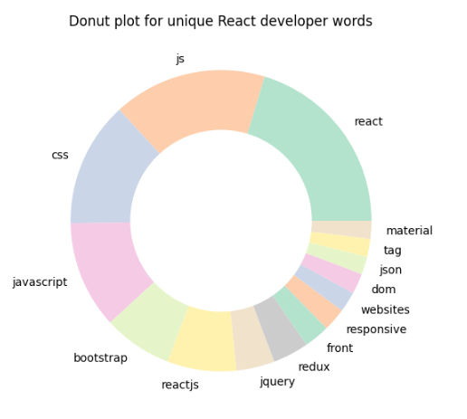
3.WORKDAY_CONSULTANT
4.REACT_DEV

Slide 14
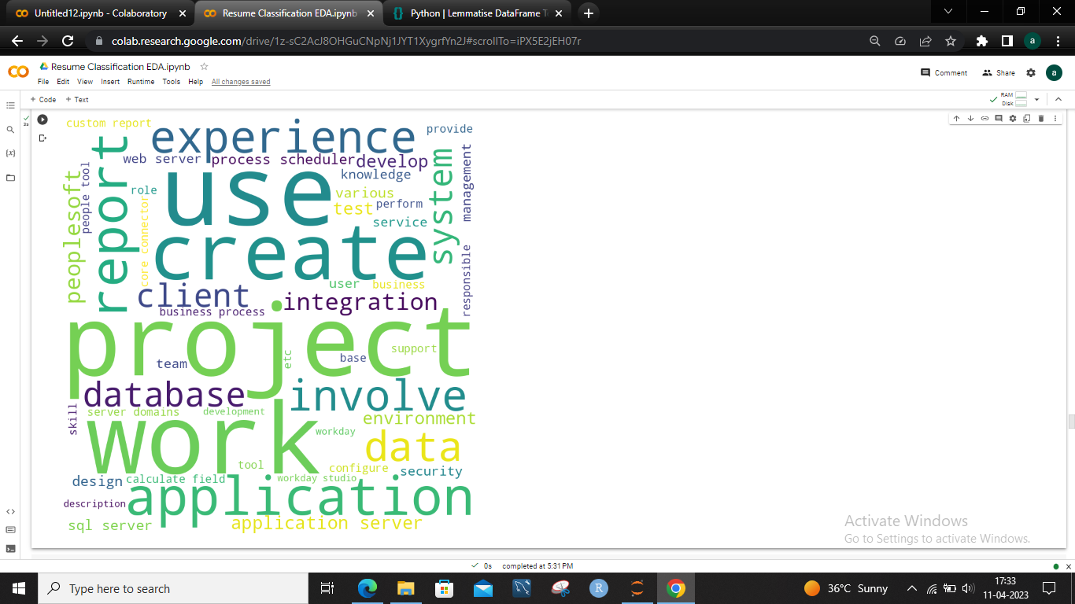
5. WORDCLOUD
It is a representation of textual data, in which the most frequently occurring words are displayed in a larger font size and the less frequently occurring words are displayed in smaller font sizes.

Slide 15
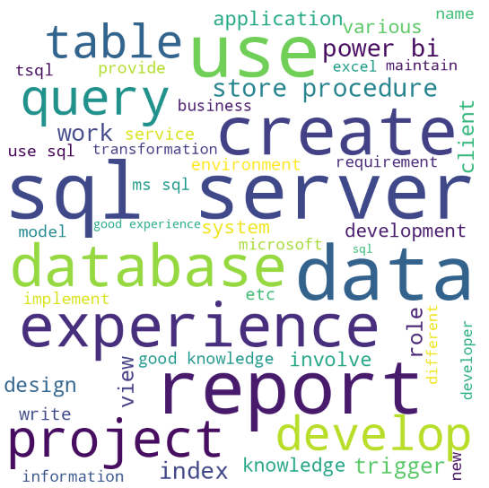
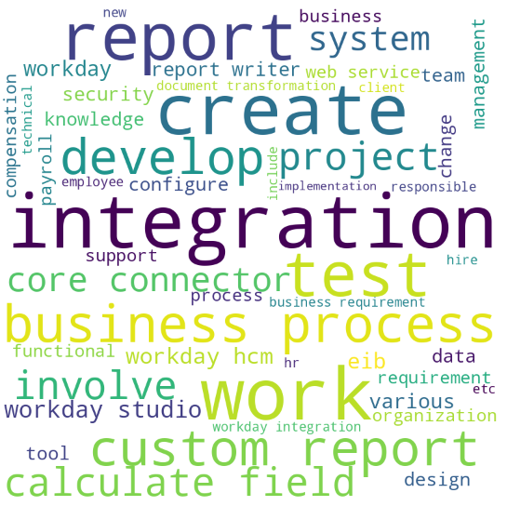
1.SQL_DEVELOPER
2.WORKDAY
In the sql developer data set the most frequent word is SQL, SERVER and REPORT.
In the workday data set the most frequent word is INTEGRATION.

Slide 16
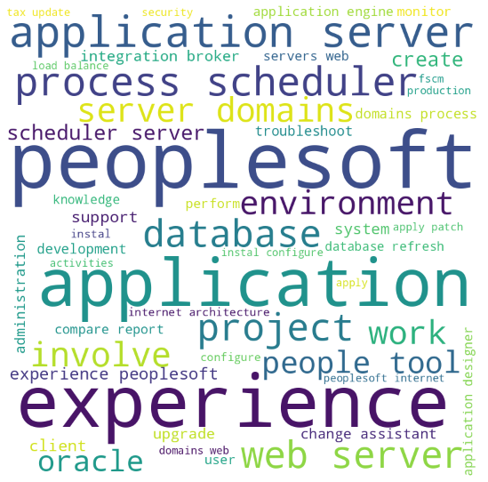
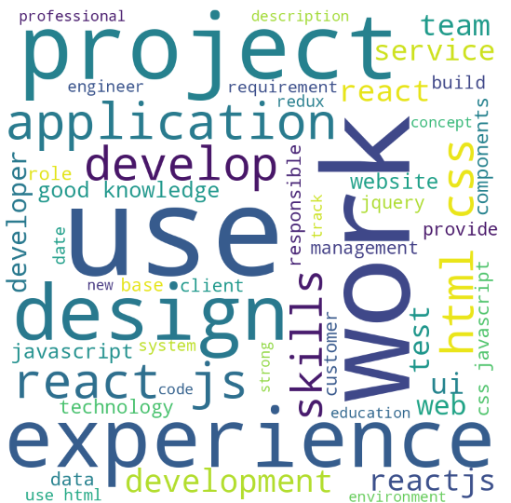
3.PEOPLESOFT
4.REACT_DEV
In the PEOPLESOFT data set the most frequent word is PEOPLESOFT.
In the react_dev data set the most frequent word is USE and WORK.

Slide 17
6.AUTO EDA
1.PANDAS PROFILING
report.html
2.SWEETVIZ
Model Building
resume_report.html

Slide 18
Model Building

Slide 19
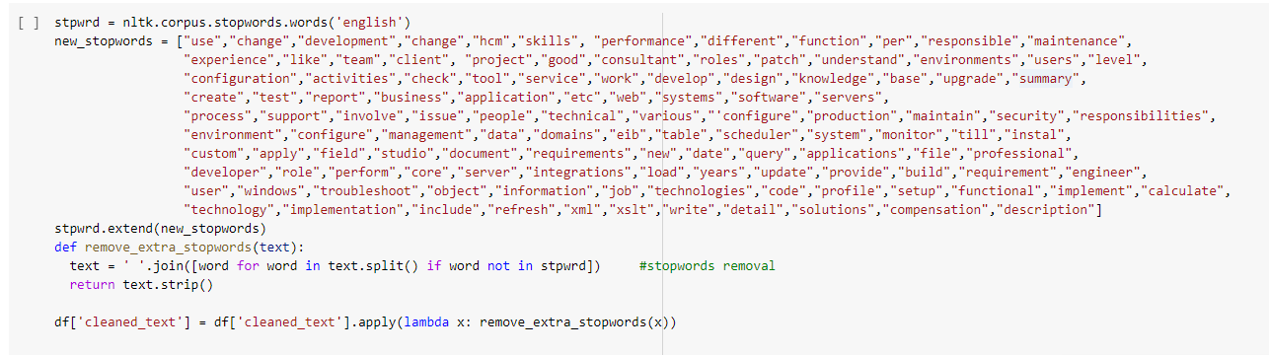
Feature extraction
We have taken out a few terms from the resume that are used frequently but don't add anything to the job function or the individual.
We've expanded the stopword list and developed a new list of common words that don't contain important information.

Slide 20
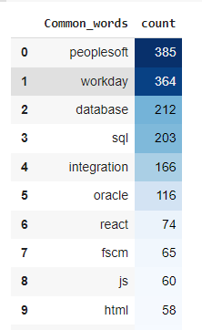
Feature Extraction
The top 10 common terms were left after the common words were eliminated.

Slide 21
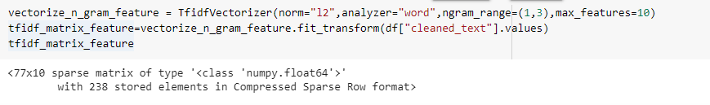
TF-IDF Frequency technique
IDF =Log[(# Number of documents) / (Number of documents containing the word)]
and
TF = (Number of repetitions of word in a document) / (# of words in a document)
TF-IDF vectorization helps classify resumes based on important keywords and phrases.
Ngram range selection impacts the granularity of feature extraction in resume classification.
Limiting the maximum number of features can improve the efficiency of resume classification algorithms.

Slide 22
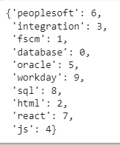
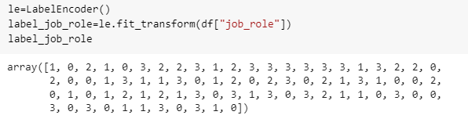
Features for model and Label encoding
These are the top 10 features, and we have built our model around them.
, and we have built our model around them.
On the job role feature, which is the feature we are analyzing, we have performed label encoding.
e are analyzing, we have performed label encoding.

Slide 23
Model building
To categories resumes according to chosen features, we examined 10 different models.
categories resumes according to chosen features, we examined 10 different models.
Naive Bayes
Decision Tree
Random Forest
Support Vector Machine (SVM)
K- Nearest Neighbour (KNN)
Multi Layer Perceptron (MLP)
Gradient Boosting
Adaboost
XGBoost
Logistic Regression for Multiclass Classification

Slide 24
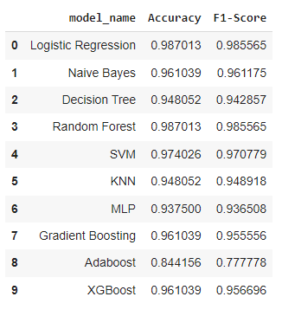
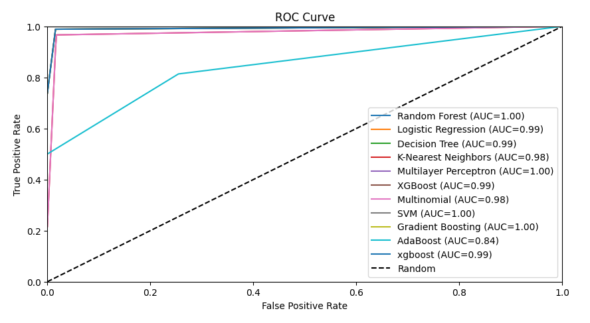
Model evaluation
We analyze each of the ten models using the accuracy_score and f1_score methods.
We can observe that the maximum accuracy and F1 Score are achieved by Random Forest and Logistic Regression.
As we can see, Random forest has the highest area under the curve, thus we also construct ROC curves for all the models.
Out of all the models, we decided to choose the random forest model for deployment.

Slide 25
Deployment

Slide 26
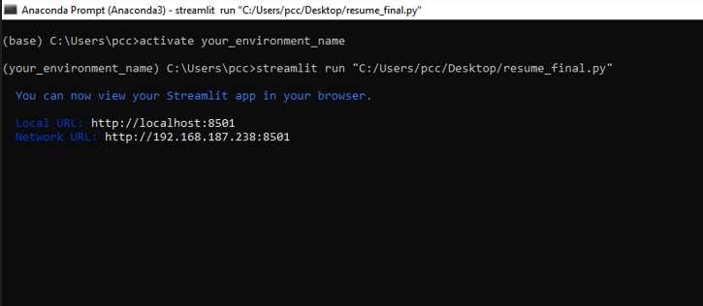
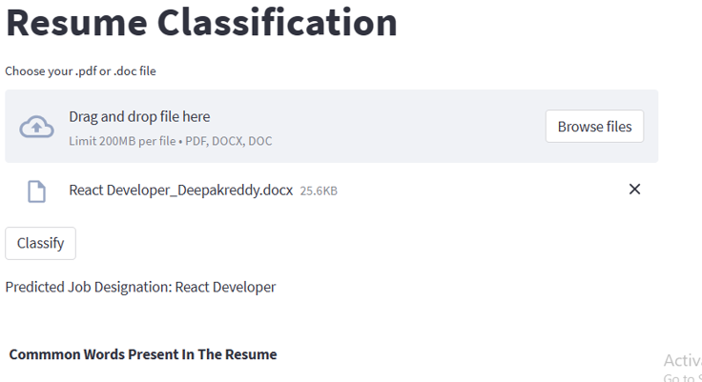
Model Deployment
The above image is about the local host number and selecting data images for analysis and deployment.

Slide 27
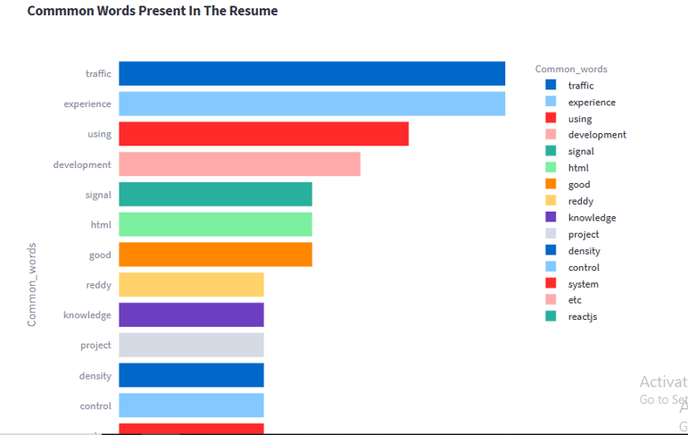
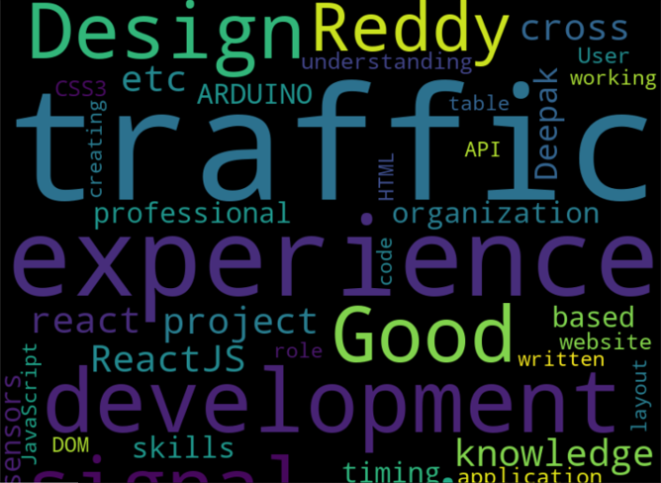
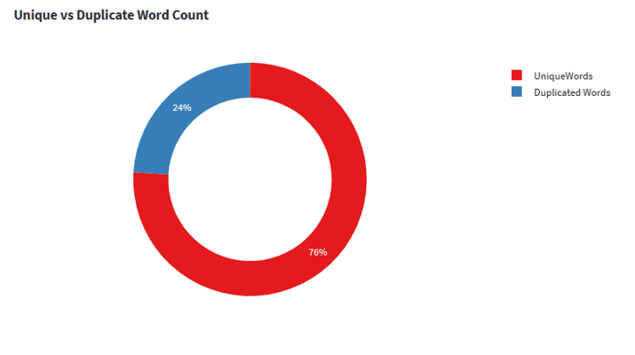
Model Deployment
Bar Plot: Top 15 common Words present in particular the resume.
WordCloud: Display most frequent words in the resume.
Pie Chart: Display percentage of unique and duplicate words present in the resume.

Slide 28
Challenges
We convert Microsoft word 2007-97 documents into word documents, which takes a lot of time because resumes are available in pdf, word document, and word 2007-97 formats.
Finding duplicates in the data is difficult because of the white space.
The excess words that do not contain important information are challenging to find and delete.
The limited amount of data makes it difficult to fit and select a final model that isn't overfit.

Slide 29
THANK YOU

